Slide 1
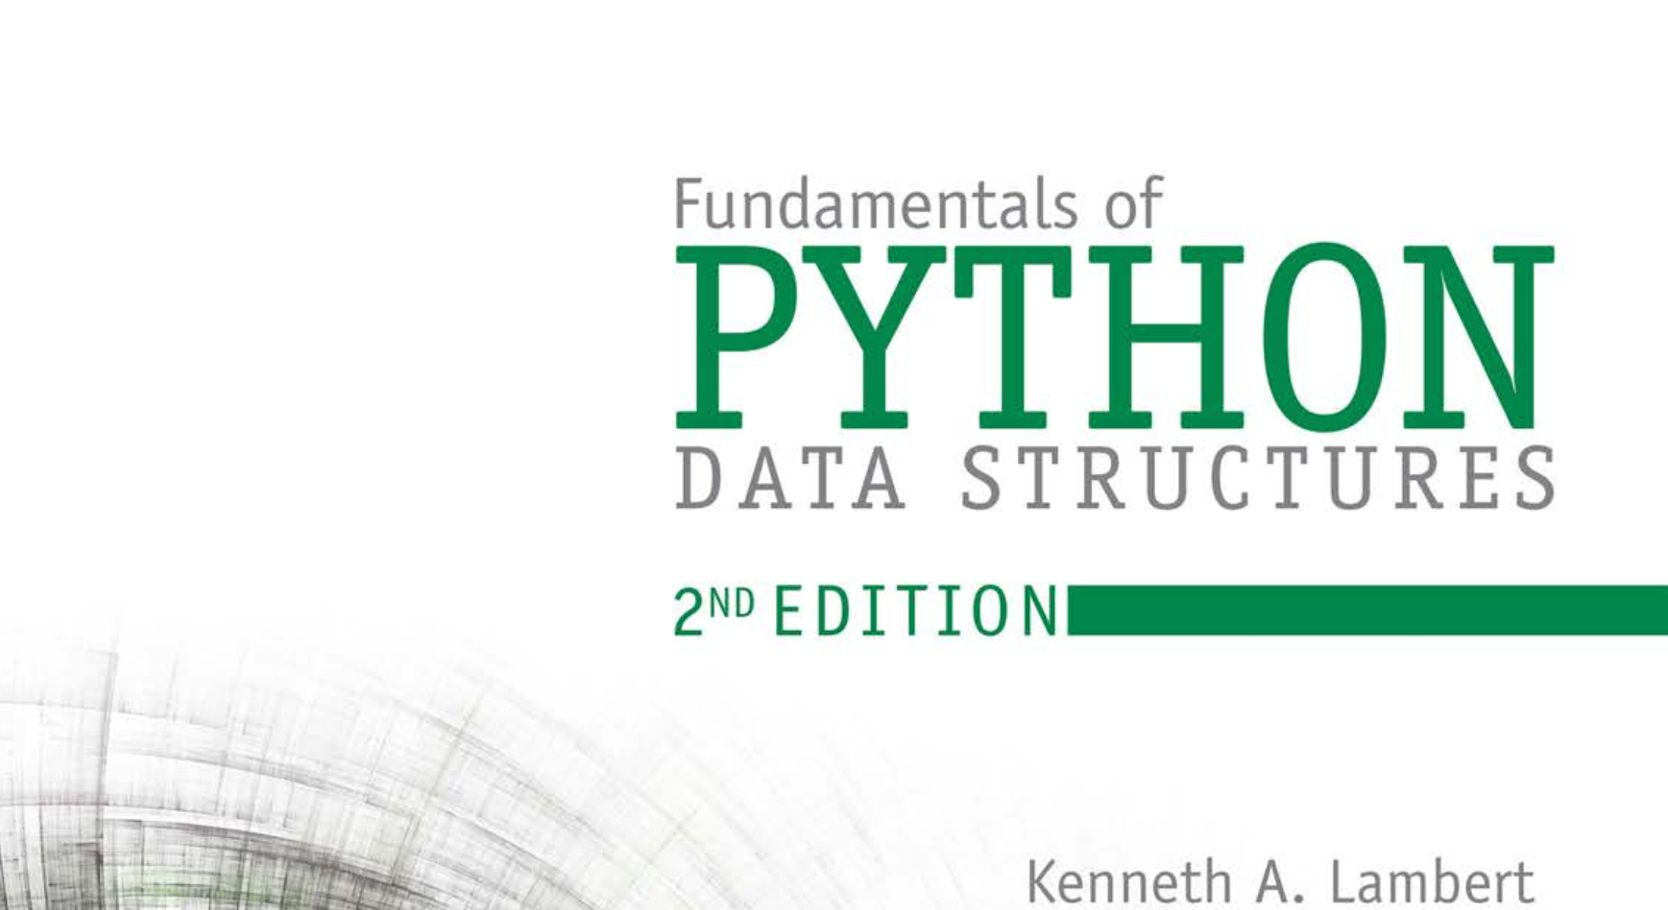
Database Systems: Design, Implementation, and Management 14th Edition
Chapter 1
Database Systems

Slide 2


National Economics University Faculty of Data Science & Artificial Intelligence
DATA STRUCTURES AND ALGORITHMS: Stack
Instructor: Duc Minh Vu (FDA – SLSCM Lab)
Email: minhvd [at] neu.edu.vn
12/19/2024
Data Structures and Algorithms in Python
2

Slide 3
Learning Objectives
Describe the features and behavior of a stack
Choose a stack implementation based on its performance characteristics
Recognize applications where it is appropriate to use a stack
Explain how the system call stack provides run-time support for recursive subroutines
Design and implement a backtracking algorithm that uses a stack

Slide 4
Overview of Stacks
Stacks are linear collections in which access is completely restricted to just one end, called the top.
Insert an element to a collection – this new element becomes top.
Remove the newest element in the collection (the top)
Adhere to a last-in first-out (LIFO) protocol.
The operations for putting items on and removing items from a stack are called push and pop.

Slide 5
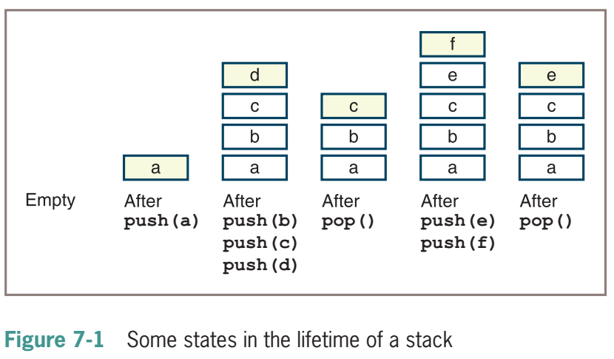
Initially, the stack is empty, and then an item called a is pushed.
Next, three more items called b, c, and d are pushed, after which the stack is popped, and so forth.

Slide 6
Some applications
Translating infix expressions to postfix form and evaluating postfix expressions.
Backtracking algorithms
Managing computer memory in support of function and method calls.
Supporting the undo feature in text editors, word processors, spreadsheet programs, drawing programs, and similar applications.
Maintaining a history of the links visited by a web browser
More: 3.02.Stacks.pptx (live.com)

Slide 7
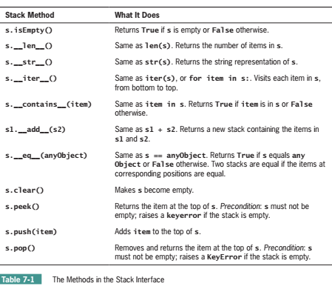
Using a Stack
The Stack Interface
push, pop, peek and other basic methods
peek = examine the top element but not pop
Instantiating a Stack
s1 = ArrayStack()
s2 = LinkedStack([20, 40, 60])

Slide 8
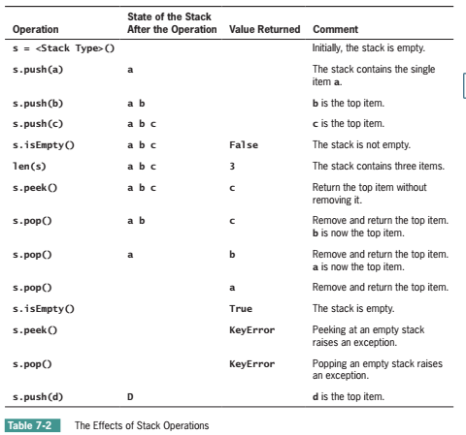

Slide 9
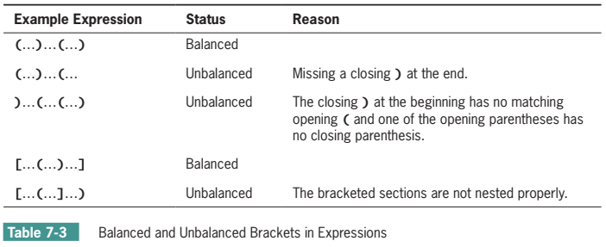
Example Application: Matching Parentheses
Determine if the bracketing symbols in expressions are balanced correctly.

Slide 10
Example Application: Matching Parentheses
Parenthesis is balanced if we can find a right match for each (open) parenthesis
We maintain a collection of parentheses that have not found matchings yet
Traverse from left to right:
If the current bracket is an open bracket : push into the collection
If the current bracket is a close bracket: check whether the newest open bracket matches the current close bracket
Remove/Pop if they are matching
Otherwise, declare unbalanced parenthesis
If the collection is not empty after checking every bracket: return unbalanced parenthesis (more open parenthesis than close open thesis) – otherwise, return true.

Slide 11
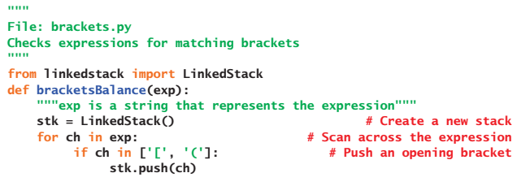
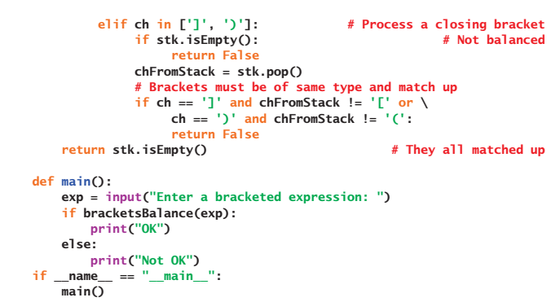

Slide 12
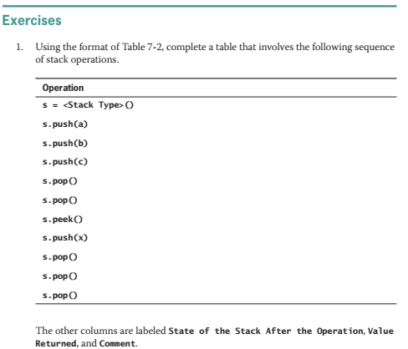

Slide 13
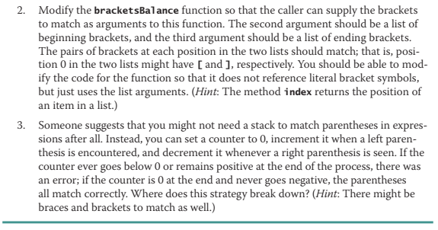

Slide 14
Three applications of Stacks
Evaluating Arithmetic Expressions
We mention only this one in the lecture
Backtracking
Memory Management

Slide 15
Evaluating Arithmetic Expressions
Infix expression: each operator is located between its operands,
Postfix expression: an operator immediately follows its operands.
People calculate infix expressions but computer calculates postfix expression

Slide 16
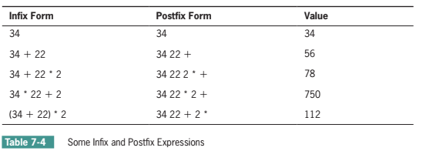

Slide 17
Evaluating Postfix Expressions
Evaluating a postfix expression involves three steps:
1. Scan across the expression from left to right.
2. On encountering an operator, apply it to the two preceding operands and replace all three by the result.
3. Continue scanning until you reach the expression’s end, at which point only the expression’s value remains.
Stack is suitable to store operands because activities in step 2 can be seen as two pops and one push

Slide 18
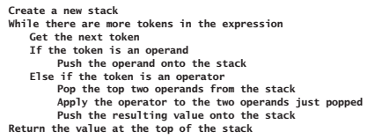
Complexity: O(n) for postfix evaluation

Slide 19
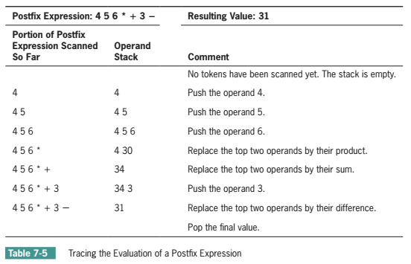

Slide 20
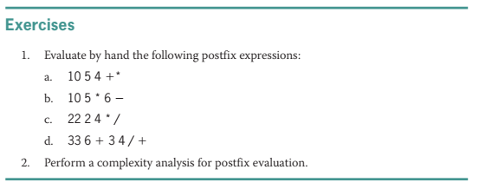

Slide 21
Converting Infix to Postfix
Steps:
1. Start with an empty postfix expression and an empty stack, which will hold operators and left parentheses.
2. Scan across the infix expression from left to right.
3. On encountering an operand, append it to the postfix expression.
4. On encountering a left parenthesis, push it onto the stack.
5. On encountering an operator, pop off the stack all operators that have equal or higher precedence, append them to the postfix expression, and then push the scanned operator onto the stack.
6. On encountering a right parenthesis, shift operators from the stack to the postfix expression until meeting the matching left parenthesis, which is discarded.
7. On encountering the end of the infix expression, transfer the remaining operators from the stack to the postfix expression.

Slide 22
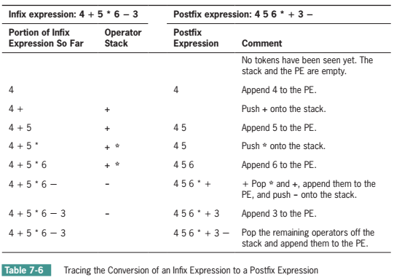

Slide 23
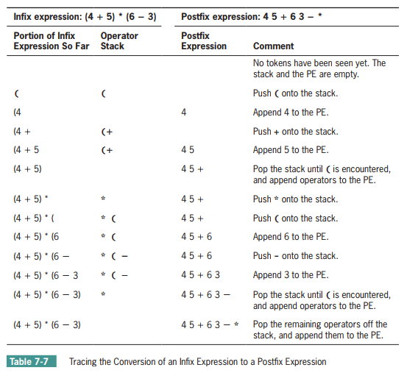

Slide 24
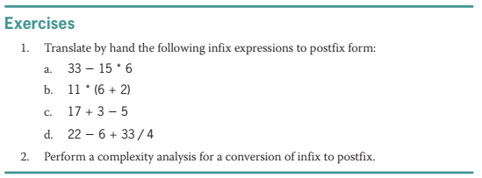

Slide 25
Implementations of Stacks
Stacks are implemented easily using arrays or linked structures

Slide 26
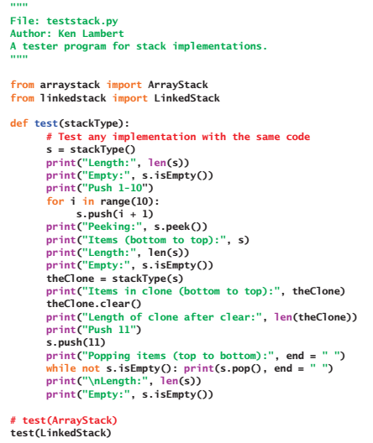

Slide 27
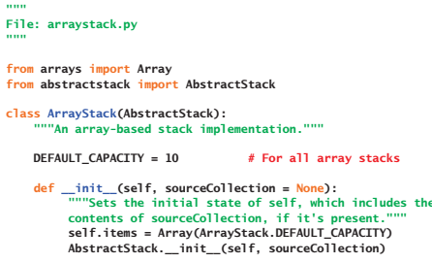
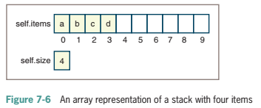
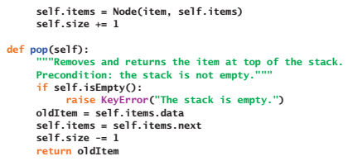
Array Implementation

Slide 28
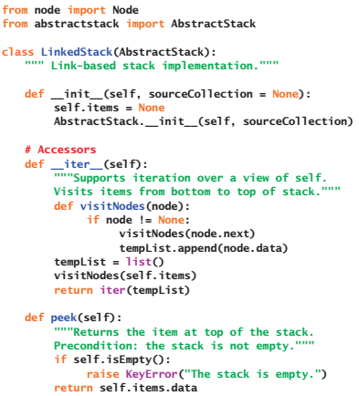

Linked Implementation

Slide 29
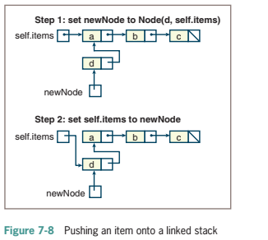
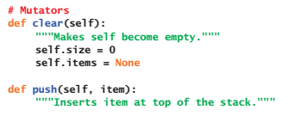
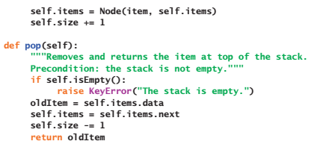
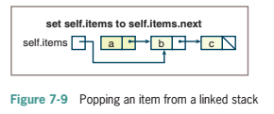
Linked Implementation

Slide 30
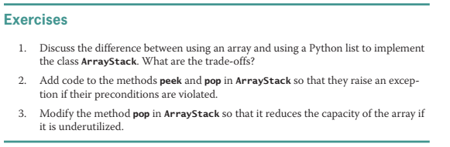

Slide 31
